Slide 1
Making your outreach more accessible to Disabled young people
Emma Diserens (Head of EDI - Programmes)

Slide 2
Housekeeping
Turning captions on
Please feel free to type questions in the chat, raise a hand, or just interrupt
You won’t be judged for using the ‘wrong’ language in this session, please do ask questions without worrying about how you are phrasing it
I do not have lived experience of any of the disabilities I am referring to, so these are generalised top tips. If you are working with a Disabled young person it is always best to ask them directly if there is anything you can do to make your session more accessible

Slide 3
Social Model of Disability
This model says that people are disabled by barriers in society, not by their impairment or difference. Barriers can be physical, like buildings not having accessible toilets. Or they can be caused by people's attitudes to difference, like assuming disabled people can't do certain things.
The social model helps us recognise barriers that make life harder for disabled people. Removing these barriers creates equality and offers disabled people more independence, choice and control.

Slide 4
Examples
You are a disabled person who can't use stairs and wants to get into a building with a step at the entrance. The social model recognises that this is a problem with the building, not the person, and would suggest adding a ramp to the entrance.
Your child with a visual impairment wants to read the latest best-selling book, so they can chat about it with their friends. The social model solution makes full-text recordings available when the book is published.

Slide 5
Language
Social Model language rejects negative or medical language and replaces it with more positive language that sees Disabled people as human beings. For example, “Disabled person” (not “handicapped”) and “wheelchair user” (not “wheelchair bound”)
According to the social model of disability, the term ‘people with disabilities’ implies disability is something caused by the individual, rather than society.

Slide 6
Language continued
Using the word ‘Disabled’ before ‘people’ signifies identification with a collective cultural identity and capitalising the ‘D’ emphasises the term’s political significance.
However, at a more individual level some Disabled people may not relate to this language. It is therefore essential that organisations also engage in regular conversations with disabled people to find out an individual’s preference around disability and the use of language.
For EnginereeingUK’s language guide go to the Tomorrow’s Engineers Website

Slide 7
End the awkward
Two thirds of Brits say they feel awkward around disabled people.
Link below for ‘End the Awkward’ video
https://www.youtube.com/watch?v=t9zUEmatYBQ

Slide 8
Be prepared
1 in 5 people have a disability
You will meet Disabled young people in mainstream schools
Some disabilities are hidden
You may have someone with a temporary disability/impairment in your session (e.g. broken arm/leg)
Changes you make will probably benefit others in the room (e.g. English as an additional language)

Slide 9
Accessible Presentations
@iamscicomm recently posted about presentations in a much more eloquent and visually appealing way than I am capable of.
@iamscicomm accessible presentation thread
She has lots of great advice about presentations so she is worth a follow.

Slide 10
Presentation top tips
Sans serif fonts, size 18 or larger
Make sure slides can be read in the order you intend
Use sufficient contrast for text and background
Give every slide a unique title
Add alt text to images and captions to videos
Check accessibility

Slide 11
Presentation top tips continued
Simple language avoiding acronyms, idioms and slang
Using technical terms is fine but try to explain them in simple language too
Descriptive language e.g., if showing a graph avoid 'as you can see' and instead describe what it is showing
Speak directly to the young person rather than their 1:1 support

Slide 12
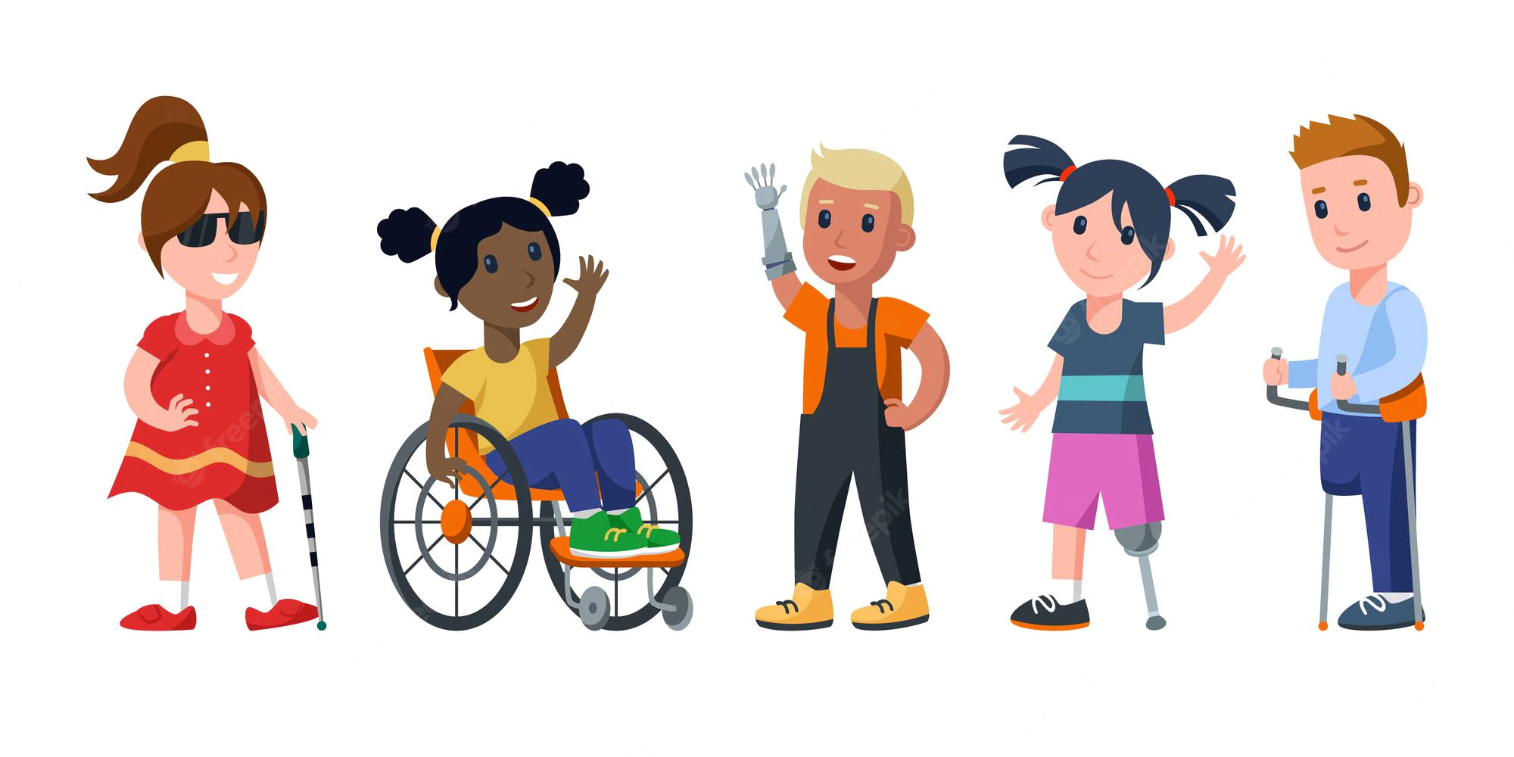
Specific disabilities and impairments
Not ‘one size fits all’
I’m going to go through some top tips in relation to specific disabilities and impairments
Worth remembering that everyone is different, even if they have ‘the same’ disability
Speak to schools in advance and ask about disabilities
Work with the teachers

Slide 13
Neurodiversity
e.g. ADHD, autism, dyspraxia, dyslexia
A very broad category and generally considered to be a spectrum
Depending on needs, neurodiverse young people may have 1:1 support
Dyslexia friendly fonts (sans serif)
Active participation
Different roles within activities
Written and verbal instructions with supporting imagery

Slide 14
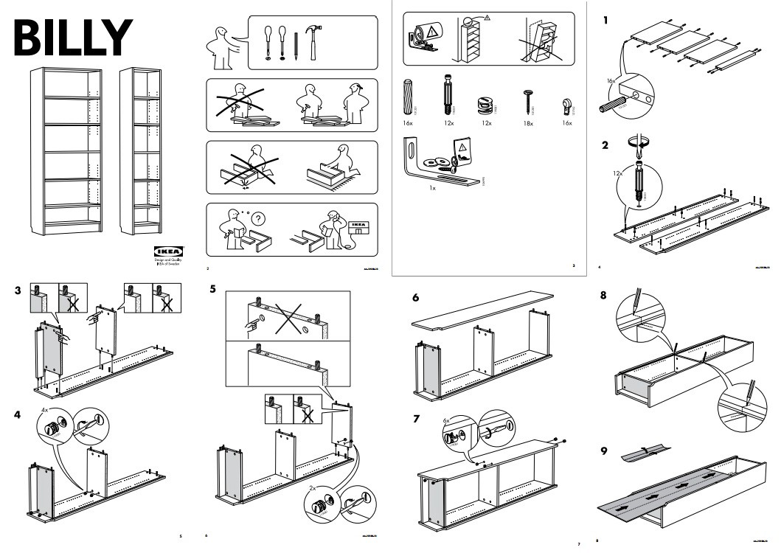

Slide 15
Neurodiversity continued
Breakout rooms
You are about to be sent into a breakout room for 5 minutes. Within your room, have a conversation about a topic of your choosing.
One person is responsible for keeping the conversation flowing – ask questions, encourage people to participate.
Everyone else can join in the conversation, ask or answer questions. BUT they cannot use any words that include the letters ‘a’ or ‘e’.
Notes:
This is a very crude exercise to demonstrate what it might be like for a young person with a processing delay.
How did you find it?
Was the ‘allocated lead’ tempted to fill the gaps? Ask more questions to help them find the words?
How did that make everyone else feel?
What’s the purpose of this activity? Reminder to give people time and space to think about an answer, don’t try to fill the gaps or find words for someone and avoid picking on people, let them volunteer to answer your questions.

Slide 16
Deaf young people
The term ‘deaf’ does not mean someone cannot hear anything. Every deaf person is different with different levels of deafness or implants, technology and communication preferences.
Just because someone is deaf it does not mean they use British Sign Language (BSL) or that they cannot speak.

Slide 17
Communication with deaf young people
Find out how they communicate (speech, BSL (or other sign languages) or a mixture of both)
Get their attention (wave, knock on a table or tap their shoulder lightly)
Face them when you are talking and don’t move around
Speak clearly and naturally (don’t speak too slowly or loudly)
Watch your mouth (covering your mouth, eating etc make lip reading harder)
Use visual cues and don’t be shy about gesturing even if not official BSL

Slide 18
Communication with deaf young people (cont.)
Make it clear what the topic of conversation is and make topic changes clear
Stand with your face to the light, shadows on the face make lip reading difficult
Speak one at a time
Reduce background noise
Never give up or say “I’ll tell you later”
Source: National Deaf Children’s Society

Slide 19
Specific adaptations for deaf young people
Subtitle any pre-recorded video content.
Use subtitles for any presentation elements you are delivering.
Book interpreters if needed.
If wearing a face mask, consider one with a clear window over the mouth.

Slide 20
Top tips for working with interpreters
Make sure it’s an English to BSL interpreter you need (this is not a certainty; you could need Irish, Scottish or Welsh Sign Language, Signed Supported English, speech-to-text reporters etc).
BSL interpreters are in short supply. If you need to book them allow plenty of time and provide as much information as possible up front.
Generally interpreters work in pairs in 15 minute ‘shifts’.
Provide a list of names and key vocabulary in advance. If there is a set script send it prior to the event.

Slide 21
Top tips for working with interpreters (cont.)
Book a rehearsal if there are any nuances or complexities.
Speak directly to the deaf young person rather than the interpreter.
Take a natural pause between slides or topic changes to ensure the interpreter has finished.
If in doubt, ask for advice. The deaf person, interpreter (and school) will have lots of experience.

Slide 22
Blind young people
Many blind and partially sighted children go to mainstream schools.
According to the RNIB, ~7% of people registered blind or partially sighted use braille.
Short cane and long white canes are for visually impaired people, red and white canes are for the hearing and visually impaired.
As with all disabilities and impairments, speaking to the school/young person in advance and asking how you can best adapt your session will result in the best outcome.

Slide 23
General tips for working with blind students
Don’t try to change your vocabulary. Avoiding verbs e.g. seeing or watching is awkward and most blind people see them as part of everyday expressions.
Announce yourself and tell them where you are within the environment.
Before you touch somebody, ask them how they prefer to be guided.
Group work is good but don’t assume the blind student is the least able.
Communicate instructions verbally and break them down into manageable chunks.
Consider producing resources in ‘large print’.

Slide 24
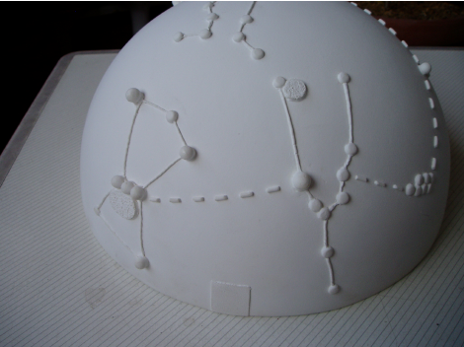
Specific adaptations for blind young people
If a young person uses braille, the school will likely have the equipment to produce braille resources.
Send resources/presentations to the school in advance so they can be loaded onto the blind person’s laptop/tech (e.g. screen reader).
Ensure all images include alt text.
Tactile resources (3D printers and pens with tactile ink).
Colour contrast is helpful.

Slide 25
Link to video about blind student coding
https://www.youtube.com/watch?v=VdPTpv26ecM

Slide 26
Wheelchair User
Wheelchair users often consider their wheelchair as an extension of themselves – do not touch them or move them without permission
Consider the set up of the room, ensure there is plenty of space between tables for wheelchair users to navigate, thoroughfares are clear and furniture is movable
If having a 1:1 conversation, sit at the same height as the wheelchair user

Slide 27
Special Schools
Just because pupils attend a Special School it doesn’t mean they aren’t capable of engaging with your activities
Speak to the teachers in advance to understand the needs of the pupils
Generally speaking, the adult:pupil ratio will be higher than a mainstream school, plan how you can use these adults
Think outside the box. Some good examples on Dr Sarah Bearchell’s website.

Slide 28
If pupils are visiting you on site
Can someone from the school visit to carry out a risk assessment?
Consider routes through the building and ensure all thoroughfares are clear.
Where possible, use a room without fixed furniture.
Check your office policy for assistance dogs and provide access to an outdoor space.
Ensure registration and security staff are aware.
Social stories. Video and print example social stories. Link to useful ‘making events accessible’ guide

